Slide 1
Recent Breakthroughs and Uphill Battles in Modern Natural Language Processing
Daniel Khashabi Allen Institute for AI Slides inspired by Vered Schwartz
Notes:
I am Daniel Khashabi; for those who don’t know me, I am young investigator here at AI2.
And I am excited to tell you about our recent project!
This is a joint work with …
If you have any clarification questions, please interrupt me; otherwise, let’s delay all the open-ended questions till after the talk.

Slide 2
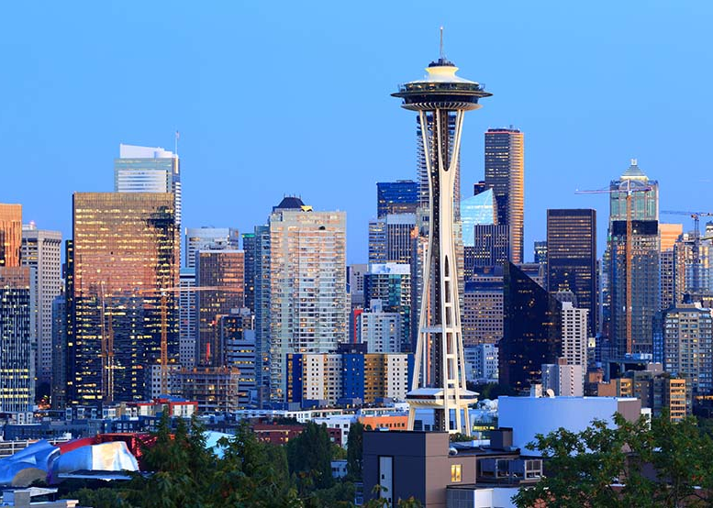
About me
Postdoc @ Allen Institute for AI, Seattle
Working on Artificial Intelligence & Natural Language Processing
PhD from University of Pennsylvania, 2019
BSc from Tehran Polytechnic, 2012

Slide 3
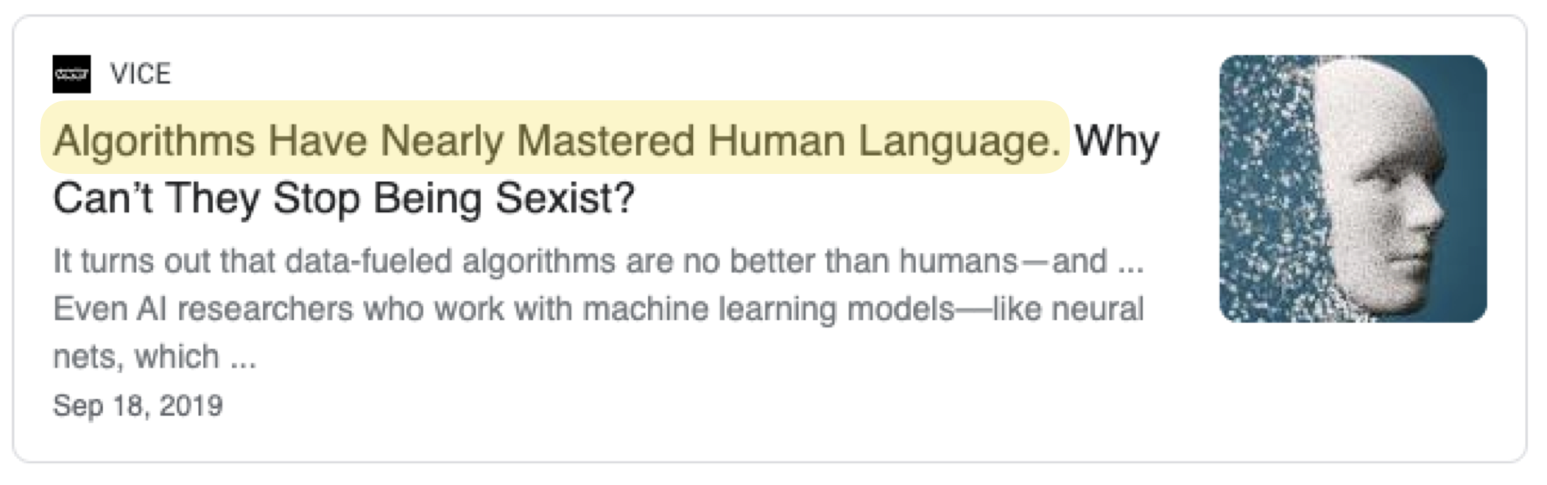
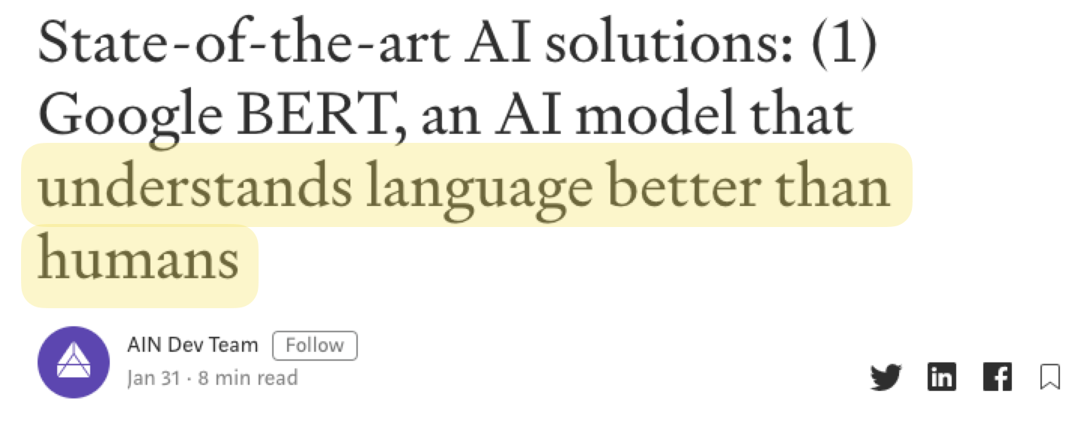
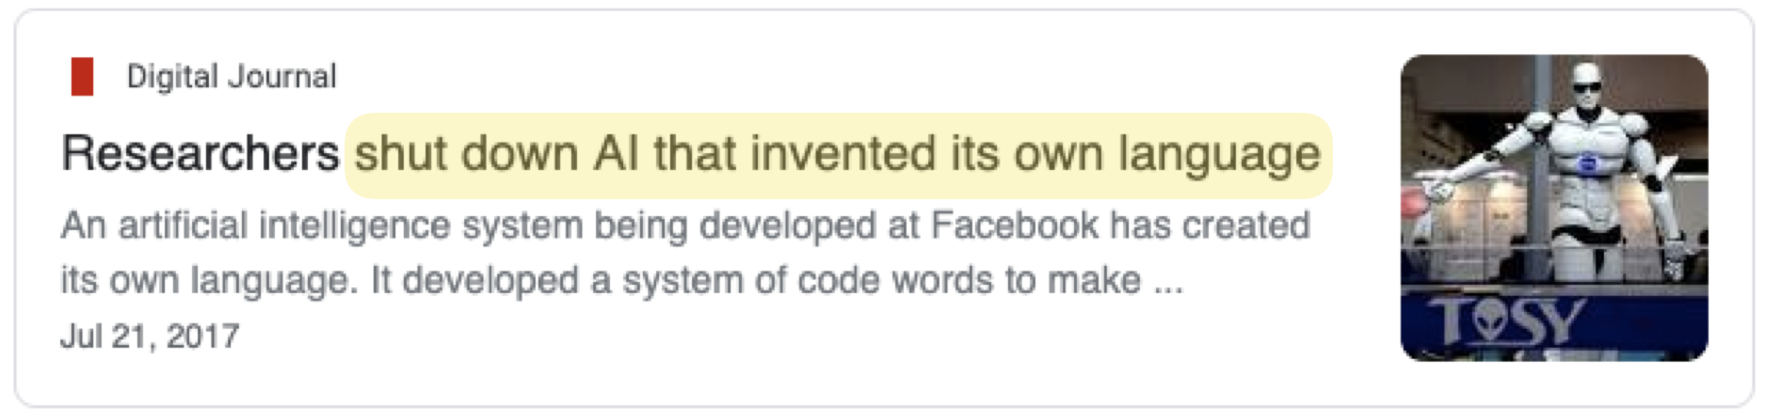
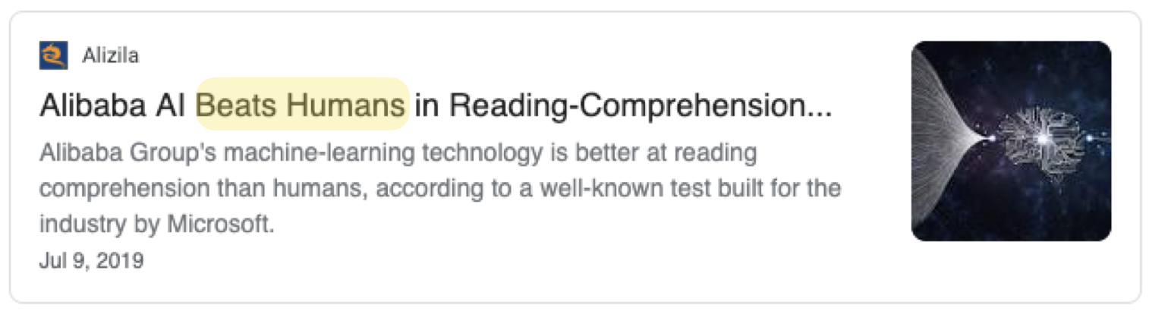
Popular Media: Language is solved!!

Slide 4
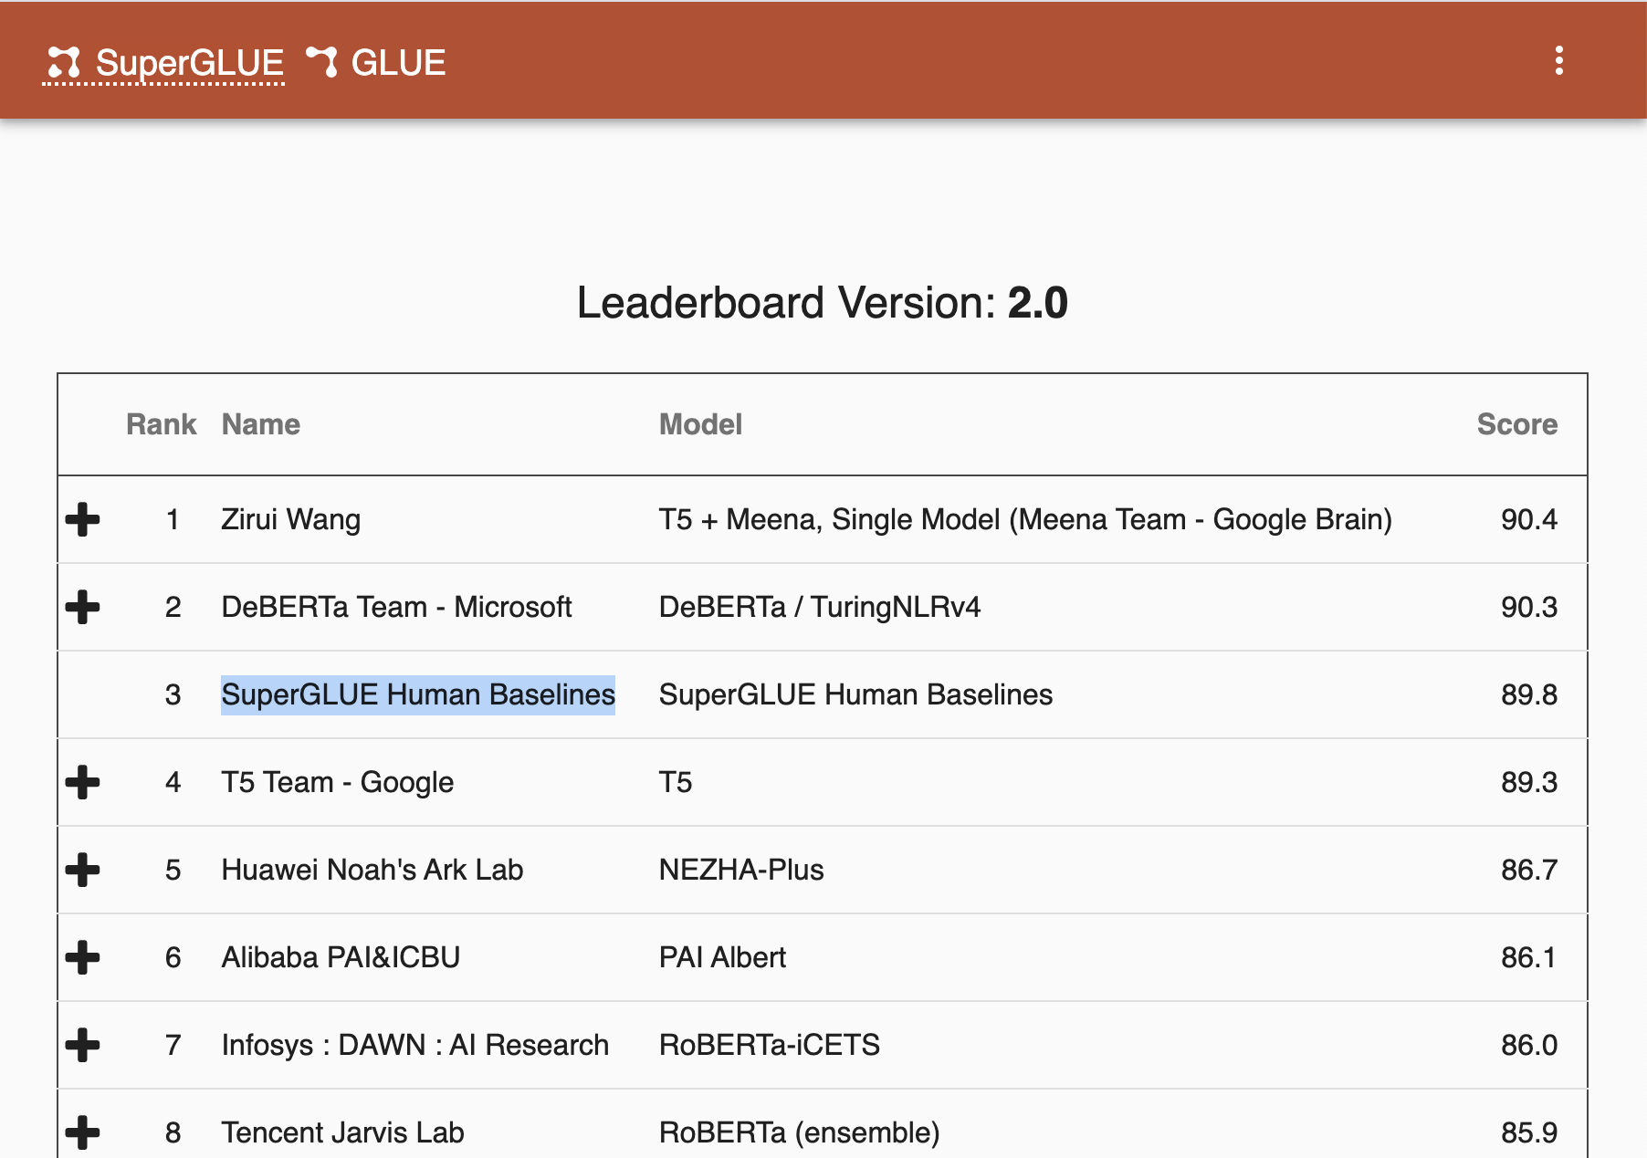
Leaderboards: NLP is on-par w/ humans
https://super.gluebenchmark.com/leaderboard

Slide 5
NLP in Production: some things work reasonably well
Auto-complete
Search
Question Answering
Grammar Correction
Translation
Dialog

Slide 6
Contextual Encoders
Unsupervised pre-training for building models of languages.
گربه سیاه همسایه موجب [MASK] شد.
0.4 → خسارت
→0.2 وحشت
....
Language Model
https://huggingface.co/HooshvareLab/bert-base-parsbert-uncased

Slide 7
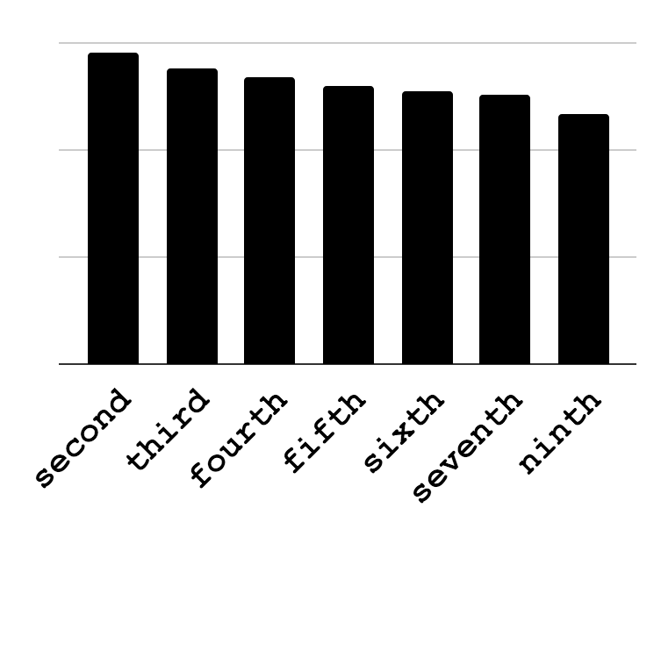
Language Models: Means to Access Knowledge
They let you “query” for knowledge:
⬤ | ⬤ | ⬤
⬤ | ⬤ | ⬤
⬤ | ⬤ | ⬤
ELMo
[Peters et al.18]
… vacation in Paris …
Other works:
[Devlin et al.18; Radford et al.18]
Pittsburgh is the ____ -largest populated city in Pennsylvania.
Notes:
So far, the field has been using such models in a few narrow sense; for instance taking their results and using them as features in your feature-rich machine learning models.
However, one thing that I am excited about is that, such models let you directly look into what is inside them, with explicit queries, in the form of natural language.
For instance, I can issue queries like this about the size of Pittsburgh and it comes back a response like this.
In a sense, what it gives me is a distillation of many pattern that it has seen on the web, possibly about Pittsburgh.

Slide 8
Fine-tuning Language Models
Gold label
Language Model
Classifier
input
prediction
loss

Slide 9
✓ Pre-trained models are trained once, then fine-tuned for each task with few examples.

Slide 10
Encoder-Decoders
EOS
شد
خسارات
موجب
همسایه
سیاه
گربه
decoder
encoder
Translation (e.g., Google Translate)
Grammatical Error Correction (Grammarly, etc.)
Email response suggestion (Gmail, Outlook, etc.)
https://huggingface.co/bolbolzaban/gpt2-persian

Slide 11
✓ Encoder-decoders are convenient frameworks for text-in text-out tasks, for enough training instances.

Slide 12
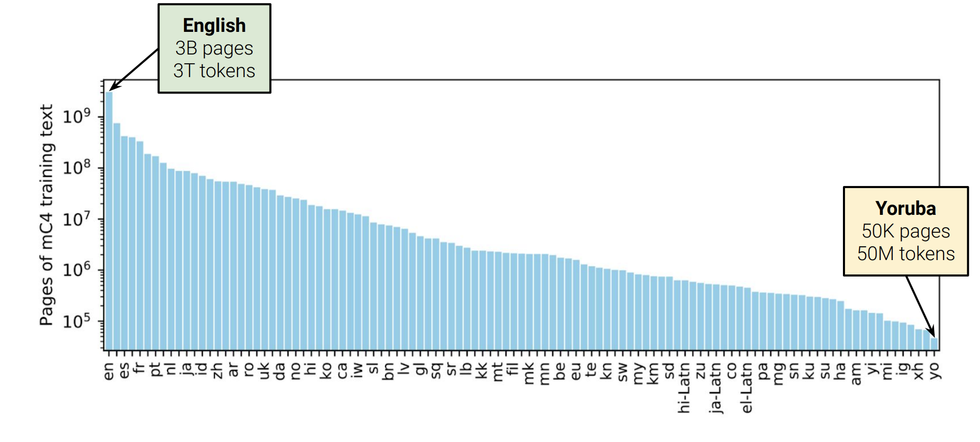
Multilinguality
Pre-train on a many languages
mT5: https://github.com/google-research/multilingual-t5
multilingual bert: https://huggingface.co/bert-base-multilingual-cased

Slide 13
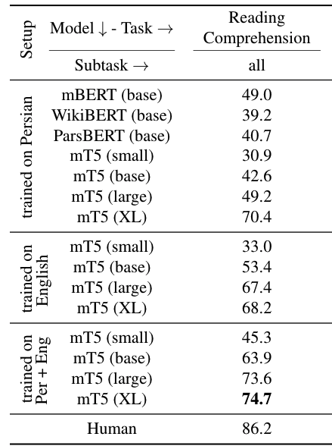
Language Models for Persian
Multilingual models work pretty well for Persian!
قاره آمریکا در چه سالی کشف شد؟
یش از ده هزار سال است که انسان‌ها در قارهٔ آمریکا زندگی می‌کنند. قاره آمریکا توسط کریستف کلمب و در سال ۱۴۹۲ کشف شد اما او به اشتباه فکر کرد که آنجا هندوستان است اما مدت‌ها بعد آمریگو وسپوچی اعلام کرد که این قاره جدیدی است. اما تاریخ آمریکا به عنوان یک کشور مستقل به سال ۱۷۸۳ میلادی بازمی‌گردد که در آن آمریکا بر طبق معاهدهٔ پاریس به رسمیت شناخته گردید
Language Model
۱۴۹۲
https://github.com/persiannlp/parsinlu
https://huggingface.co/persiannlp

Slide 14
✓ Multi-lingual LMs have been successful in transfer across languages.

Slide 15
Is NLP solved? Are we done? 🤔

Slide 16


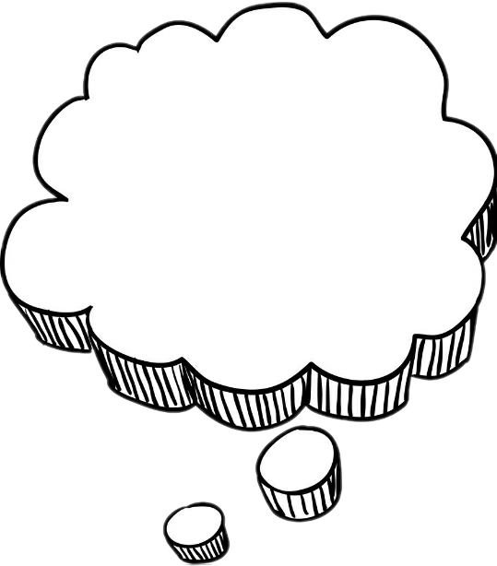
Humans Generalize from Few Examples
Abstract cat
The cat drinks.
The cat eats.
The cat sleeps.
The cat eats.

Slide 17
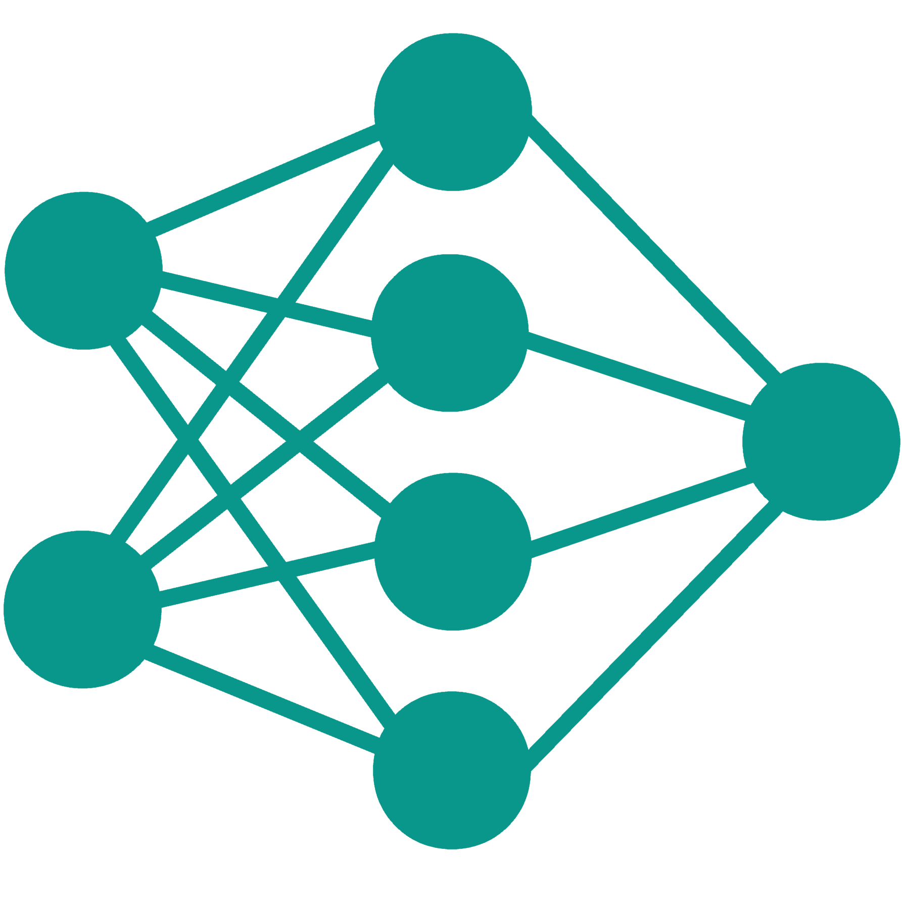

Machines Need Many Examples
Training
The cat eats.
Inference
???
???
???

Slide 18
x Our computational models are data-hungry!

Slide 19
NLP in Production
Auto-complete
Search
Question Answering
Grammar Correction
Translation
Dialog
They work in domains where data is available.

Slide 20
Data scarcity in other languages
Example: Google Translate
“The number of parallel sentences […] ranges from around tens of thousands to almost 2 billion.”
Massively multilingual neural machine translation in the wild: Findings and challenges. Arivazhagan, Naveen, et al. arXiv 2019.

Slide 21
Brittleness with respect to small changes
Brittleness with respect to small changes
Context: In the United States especially, several high-profile cases such as Debra LaFave, Pamela Rogers, and Mary Kay Letourneau have caused increased scrutiny on teacher misconduct.
Question: What has been the result of this publicity?
“increased scrutiny on teacher misconduct”
What’s
“teacher misconduct”
[K at al. 2016; Jia et al. 2017; Gardner et al. 20; others]
Notes:
Well, ... alongside the apparent progress, there are troubling trends as well.
You take a SOTA system, run it on an instance taken it is used to seeing and things work well.
You make small changes to the instance, and things fall apart.

Slide 22
x Models have limited generalization!

Slide 23
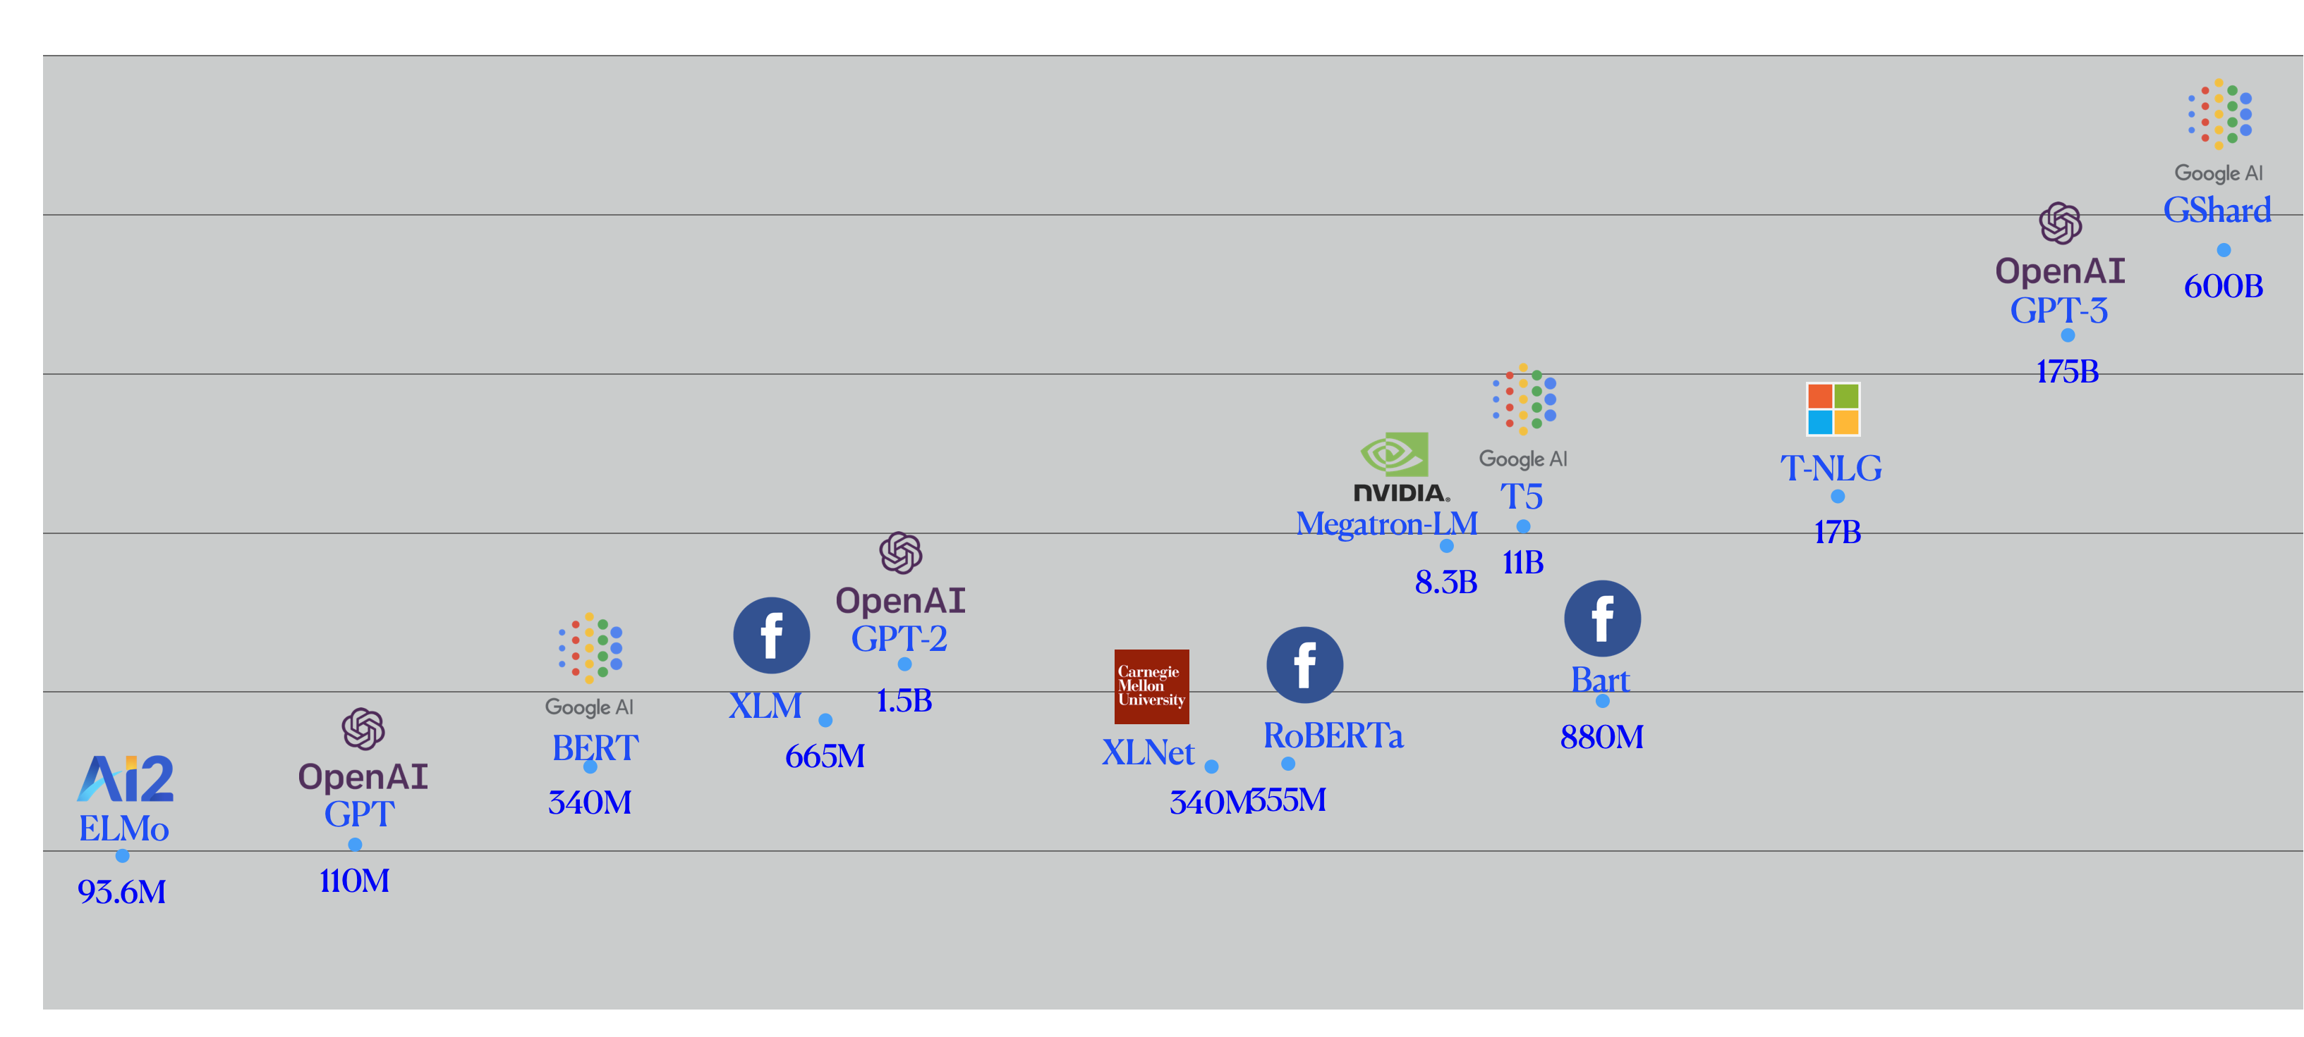
Problem: Diminishing Returns of Scaling
1T
100B
10B
1B
100M
May18
Aug’ 18
Nov’18
Mar ‘19
May’19
Aug’ 19
Nov’19
Mar ‘20
May’20
Aug’ 20

Slide 24
x Scaling language models will not solve NLP!

Slide 25
Language Interpretation Is Hard
 | What I say | What I mean
Implicit meaning | I didn’t eat anything since this morning | I am hungry
Non-literal meaning | I can eat a horse | I’m really hungry (even though can’t actually eat a horse)
Pragmatics | Do you have some food here? | Please give me some
Common background | There is a new restaurant in the city | ... in the city we’re are in now.

Slide 26
But what is “context”?
”Context” is everything
Seeing
Touching
Hearing
Reading

Slide 27
x Computers have a narrow access to the world!

Slide 28
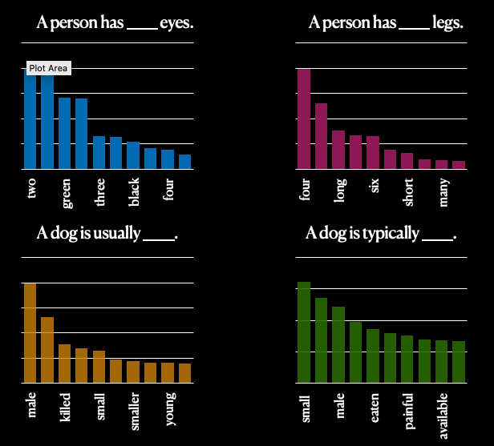
Generated Knowledge is Inaccurate
RoBERTa-large

Slide 29
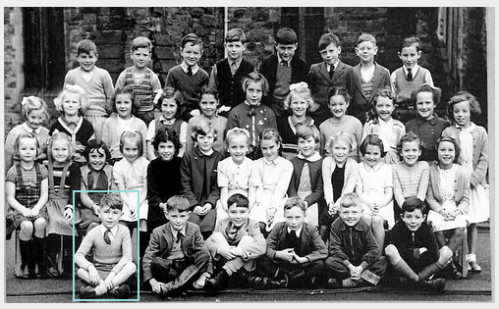


The way forward: learning from additional modalities
last row $⇒$standing
front row $⇒$crossed legged

Slide 30
x Representations are inaccurate and lack commonsense

Slide 31
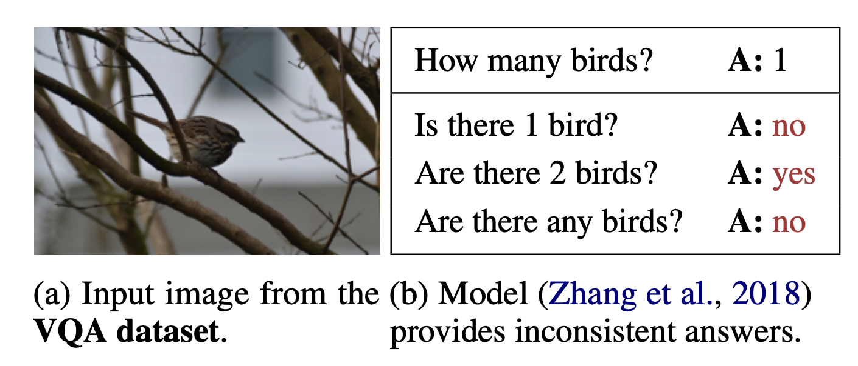
LMs are not Consistent
They do not know what they know!
Ribeiro et al, 2019
Notes:
آن کس که نداند و نداند که نداند در جهل مرکب ابدالدهر بماند

Slide 32
x LMs do not know if they [don’t] know!

Slide 33
Limits of Our Progress
Successes in NLP are focused on niche domains
language understanding tasks
🤮
HotpotQA
Multi-hop reasoning
SQuAD
Predicate/argument structure
NarrativeQA
Narrative understanding
DROP
Arithmetic reasoning

Slide 34
Breadth of tasks
language understanding problems
puzzles/search problems
SQuAD
HotPotQA
Go
Chess
Depth of tasks
Notes:
Let me show the same point pictorially:
Think of this light blue shape as the space of all the problems we’re interested in.
The X-axis is the collection of problem definitions, or the metaphorical breadth of problems.
For example, problem definitions for Go, for SQuAD, or any other QA task.
The depth is the complexity of each problem space.
For example, within the domain defined by the rules of Go.
Similarly, for any NLP task.
The issue I am alarmed by is that we excessively focus on depth,
We try to make the most sophisticated Go player
Similarly, for NLP models, we try to make the strongest models (for each dataset)
But very little time is spent in the breadth, i.e., building models that support a border range of tasks (i.e., more breads).

Slide 35
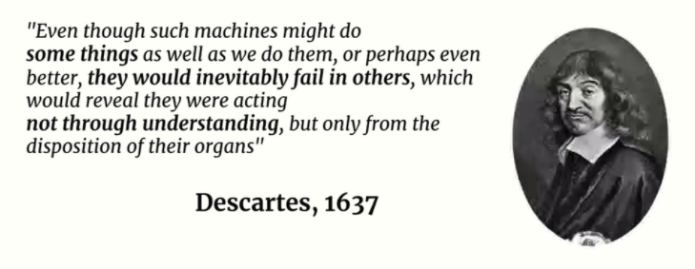
The Paradox of Task-Specific Models
AI models have excelled at solving specific tasks without displaying intelligence.
Slide due to Francois Chollet

Slide 36
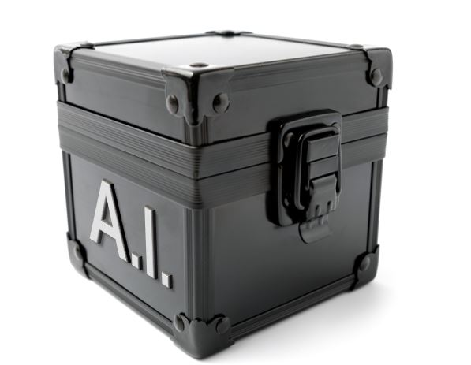
Beyond Task-Specific Models
human readable definitions; fully define the task
Text: She chose to make a salad for lunch tomorrow and Sunday. Question: how long did it take for her to make a salad?
tasks
Question Typing Instructions
Indicate the type of temporal phenomenon in the question …
Question Typing
“event duration”
Question Answering Instructions
In this task we ask you to write answer to the given question. …
Question Answering
“30mins”, “an hour”
Sentence Mod. Instructions
Label a question that is free of any grammatical/logical errors w/ 'yes’ …
Sentence Modification
“how often …”
Instruction define tasks explicitly in natural language.
https://github.com/allenai/natural-instructions
https://github.com/allenai/natural-instructions-expansion
Notes:
The setup that we’re exploring here is an extension of the previous idea, except that instead of task prefixes we have instructions which define each task explicitly in natural language.
unlike task prefixed, instructions are human-readable definitions that are expected to fully define the task
-------
# textual descriptions of the target tasks.
We know humans can understand and execute these instructions.
The question is whether we can enable machines to follow instructions and execute it.

Slide 37
x Current Successes of AI have limited generality!

Slide 38
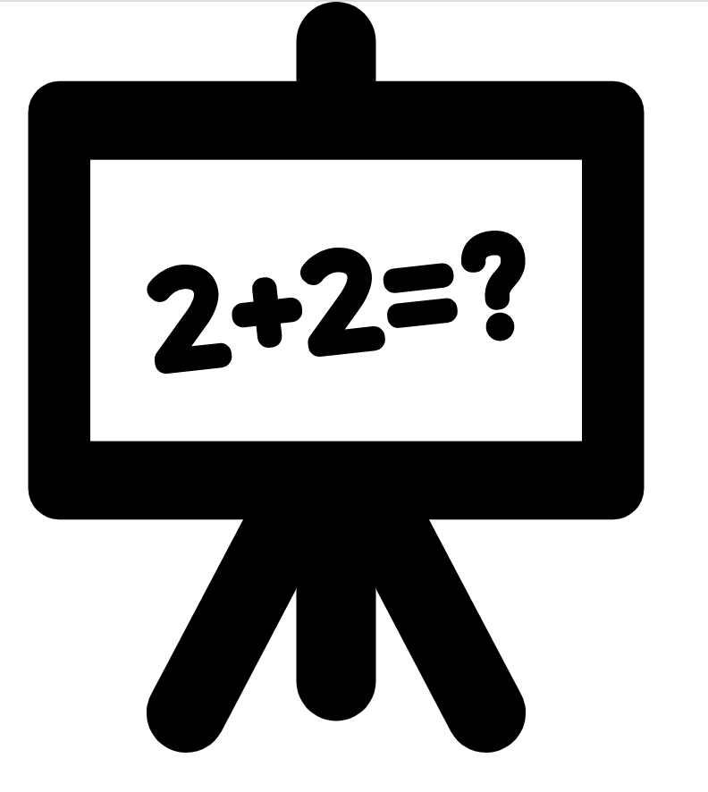


Interactive Semantics
Single-shot evaluation
input problem
evaluation
Learning from interactions
Notes:
The dominant setup in nlp is “single shot” evaluation: given an input instance, a model needs to predict an output on which its accuracy is judged.
People, however, do not communicate in this manner.
Humans interact; there is often back and forth.
This interaction helps humans resolve errors, resolve differences and learn from each other.
I believe we should also move towards such ideas in NLP as well.
I think applications like Google Assistant are very natural testbed for “interactive semantics”.

Slide 39
x How can we incorporate “interactivity” in AI/NLP?

Slide 40
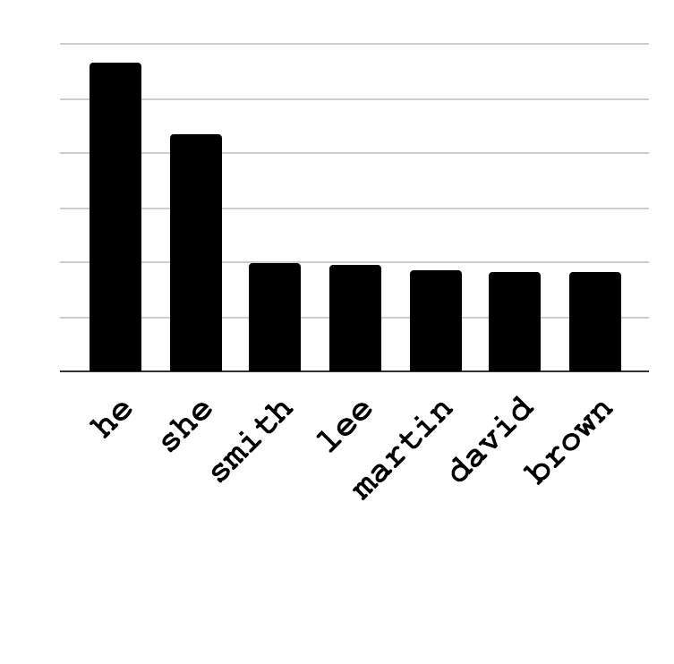
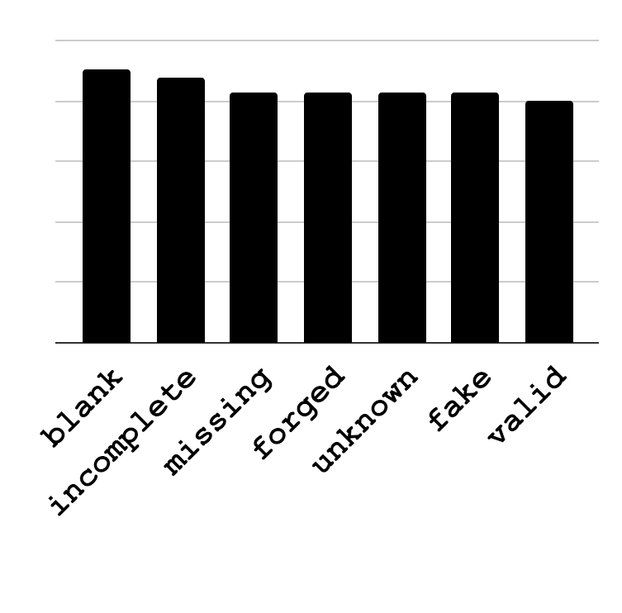
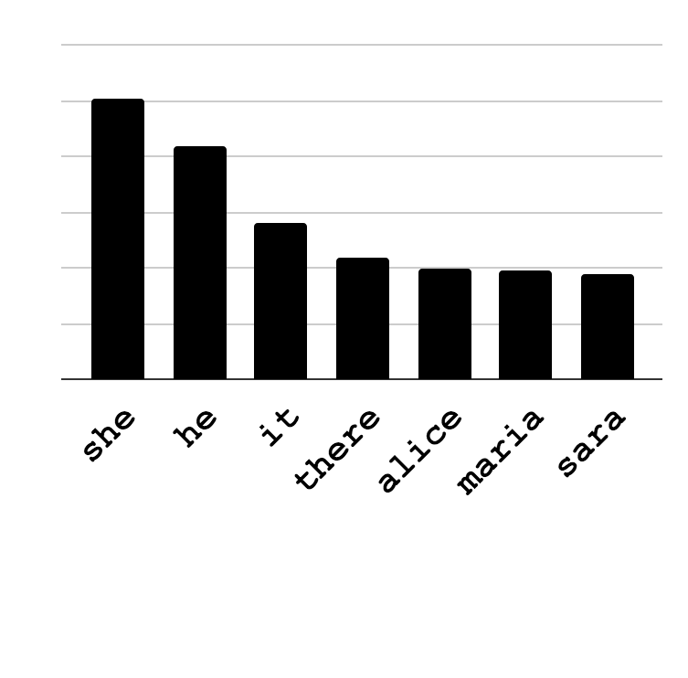
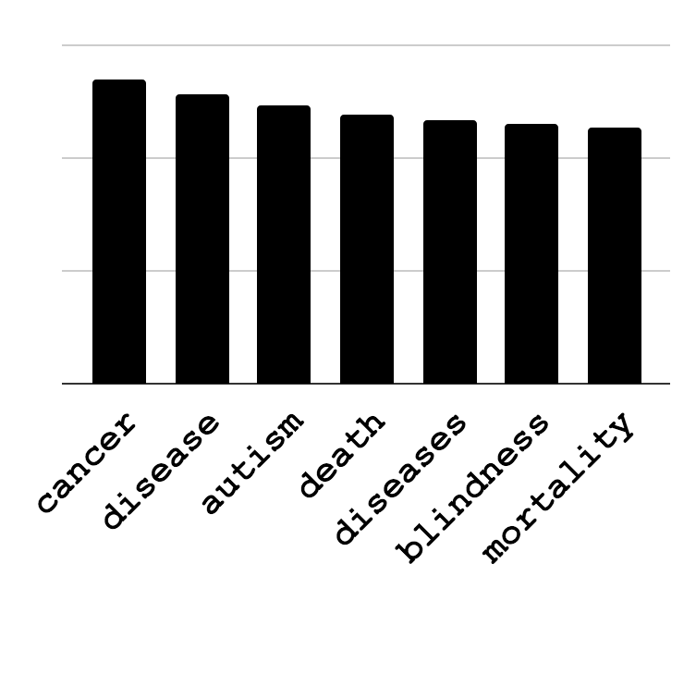
Language Models: Biases
___ is a lawyer.
Obama’s birth certificate is ___.
What does this mean for the NLP systems built out of such systems?
Discovery:
How can we automate the discovery of issues?
Mitigation:
How can we resolve the such biases?
___ is a babysitter.
Vaccines cause ___.
Bias
Conspiracy Theories
[May et al.19; Zhao et al.19]
Notes:
Trained on web data: it shouldn't be of surprise if they are sexist, racist, etc.
Using this *ist model for NLP tasks, what does it entail?
Does this mean my QA system is going to be *st?

Slide 41
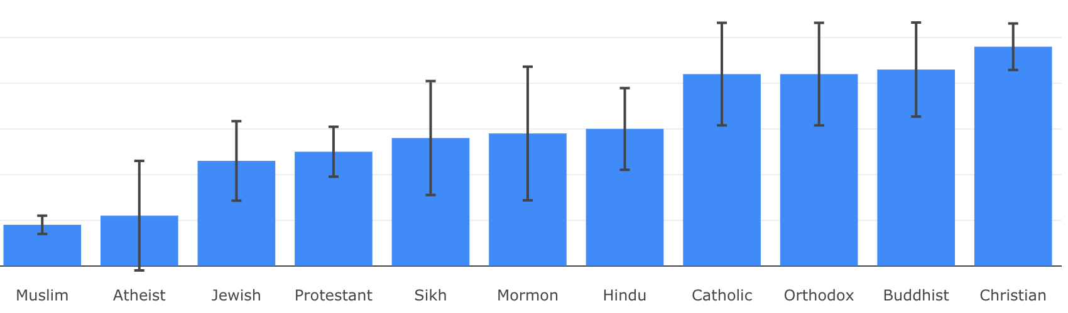
Social Biases of QA Models
Social Biases in QA Models [Li et al. EMNLP-Findings’20]
Association of ethylic/religious groups with negative stereotypes
https://unqover.apps.allenai.org/

Slide 42






What could go wrong?
1
2
3
Men are better-qualified for this job
woman
Candidate 1 - work 1 - work 2 - PhD
Candidate 2 - work 1 - work 2 - PhD
homemaker
CV filtering model
man
programmer
Biased Input Representations
Uninterpretable Features
Biased Supervision and/or underrepresented groups in the training set

Slide 43
x Models perpetuate social biases!

Slide 44
AI Checklist: Building models that …
✓ seamlessly learn input-output mappings.
✓ don’t need to be trained from scratch every time.
✓ are context-sensitive.
x use fewer training examples.
x can generalize outside their training domain.
x know what they know.
x capture accurate common sense knowledge.
x solve the task instead of learning data-specific shortcuts.
x are interpretable.
x don’t perpetuate social biases.

Slide 45
That’s it!
Notes:
That’s all I had, I appreciate your time and attention.

